Slide 1
Coverage-Directed Differential Testing of JVM Implementations
The 37th annual ACM SIGPLAN conference on Programming Language Design and Implementation (PLDI 2016)
Shared by Jingtang Zhang
2020.02

Slide 2
Java Virtual Machine
Write Once, Run Anywhere.
Java Virtual Machine
Java Compiler
Java
Bytecode
Class Loader
Linux ARM32/64
Executor
Linux i586/x64
JIT Compiler
macOS x64
Kotlin
Garbage Collector
Solaris x64
Scala
Windows x86/x64
…
Groovy
…

Slide 3
Java Specification
Java Compiler
Java
Bytecode
JVM
Java Language Specification
Java Virtual Machine Specification
Java 1.0-1.5
Oracle HotSpot
IBM J9
GNU GIJ
Java 6
Java 7
compatible
Java 8
Java 9
Java …

Slide 4
JVM Discrepancy && Defect
e (environment)
c (Java class)
i (input)
r (observable result – output/error)
Discrepancy && Defect:
r1 = jvm1(e, c, i)
r2 = jvm2(e, c, i)
r1 ≠ r2
Bytecode
Oracle HotSpot
IBM J9
GNU GIJ
…

Slide 5
Classfuzz
Coverage-guided fuzzing approach that focus on constructing representative class-files for differential testing of JVM’s startup process.

Slide 6
JVM’s Startup Process
Coverage-guided fuzzing approach that focus on constructing representative class-files for differential testing of JVM’s startup process.
Bytecode
JVM
Loading
Verification
Preparation Linking
Resolution
Initialization
// start using…
Bytecode content
Magic value
Minor/major version
Constant pool
Access flags
Class index
Interface
Fields
Methods
Attributes

Slide 7
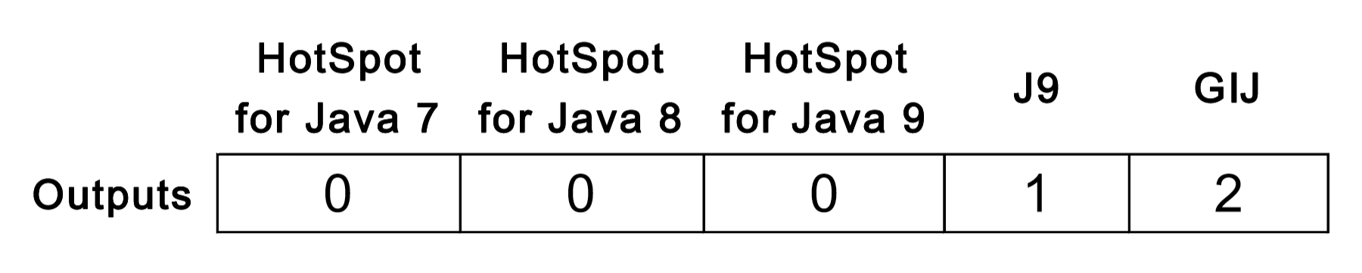
Differential Testing
Coverage-guided fuzzing approach that focus on constructing representative class-files for differential testing of JVM’s startup process.
Bytecode
Oracle HotSpot
0. Normally invoked
1. Rejected during the loading phase
2. Rejected during the linking phase
3. Rejected during the initialization phase
4. Rejected at runtime
IBM J9
GNU GIJ
…

Slide 8
Representative Class-files
Coverage-guided fuzzing approach that focus on constructing representative class-files for differential testing of JVM’s startup process.
JVM
Bytecode 1
Bytecode 3
Bytecode 1
Bytecode 2
Seed pool
Bytecode 3
A reference JVM
Unique execution path

Slide 9
Mutating Class-files
Soot
A state-of-the-art Java analysis and transformation framework
Rich APIs for parsing, transforming and rewriting class-files
129 mutators

Slide 10
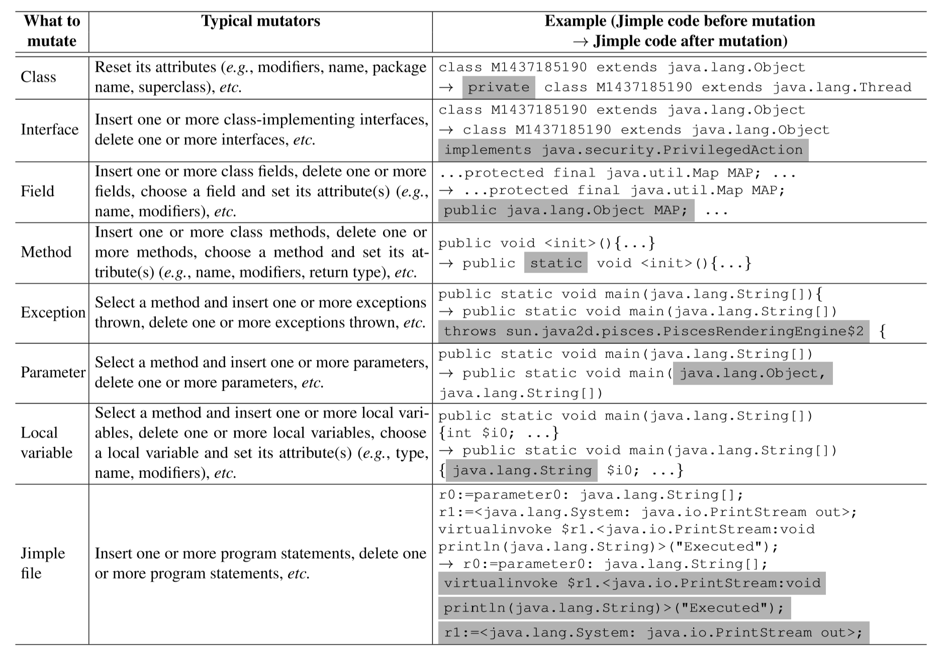
Mutating Class-files

Slide 11
Mutator Selection
mutator 86
mutator 49
mutator 4
mutator 101
mutator 23
…
2133 seeds
2098 seeds
2063 seeds
1954 seeds
1866 seeds
Select mutators at random, accept/reject the mutators by a Metropolis choice
Mutators with high success rate will be more easily selected
The sampled mutators meet the geometric distribution

Slide 12
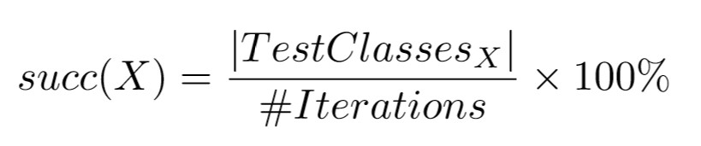
Evaluation – Results on Class-file Generation
Metric – success rate
Invalid seeds
Non-uniqueness
Random fuzz
Other mutator selection algorithm
MCMC (in this paper) – utilize the prior knowledge to select mutators

Slide 13
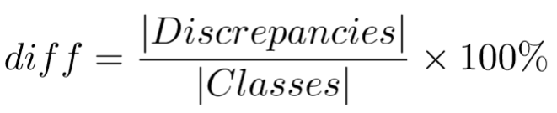
Evaluation – Differential JVM Testing
Metric – differential rate
JVM discrepancies can be exaggerated by class-file mutants
364 / 21736 of JRE 7 class-files
107 / 898 mutants
The clause in the JVM specification caused unreasonable amount of confusion
JVM take their own class-file verification and type checking polices
JVMs are not compatible to access some classes
…

